Slide 1
For more details, see the comments on the slides (Review tab > Show Comments)
Hi!
Big changes
Slide 8
If possible, please change “Trigger” to a different verb (per the AWS style guide).
I changed "Argo workflow" to "Argo Workflows" based on the context and the Argo Workflows documentation online.
Slide 17: I've hidden this slide because the event access code is still a placeholder.
Slides 19-21
I updated the lists of re:Invent sessions on these slides based on the re:Invent catalog.
Please check all the sessions before you present because some session titles and times/dates might change before you present.
I’m Lisa
I’m a technical editor on the Global Content Editing team. My role is to ensure that AWS event content is accessible, appropriate, and accurate. See a summary of my edits on the right.
This edited version is the one approved to present. If you need to make changes to the deck before presenting, please make them in this version. Then, unless directed otherwise, schedule an onsite speaker ready room (SRR) deck editing appointment when booking opens or join a deck editing walk-in queue onsite. The technical editing team will review the changes and add them to the controlled version of the deck.
Little changes
Corrected spelling, grammar, and punctuation
Ensured correct AWS service names
Applied consistent capitalization (sentence case)
Applied the updated template, colors, layouts, and fonts
Adjusted line weights to the minimum standard (1.5 pt)
Adjusted font sizes to the minimum standard (12 pt), where possible
Minor edits for AWS style
Questions? Email globalcontentediting@amazon.com
AWS SPEAKERS: If you are speaking about generative AI, be sure to review the required resources: https://w.amazon.com/bin/view/AWS/Events/AWS_reInvent_Speaker_Resources/

Slide 2
Welcome slide

Slide 3
Kubernetes DevOps tooling meets SaaS: Automating tenant provisioning
SAS407
Rodrigo Bersa
Senior Containers Specialist SA
WWSO
Notes:
In this session you will review a DevOps automation solution that solves the challenge SaaS brings to DevOps – how multi-tenancy can affect DevOps processes – and how you can use Kubernetes open source tooling to help you overcome these challenges. As you will see, we have chosen some specific tools, but basically you can replace them for other tools. What’s really important is to understand the concepts and hopefully you can applied some of it in your own use cases.

Slide 4
DevOps and SaaS
Agility
Operational efficiency
Frictionless onboarding
DevOps supports SaaS scale and growth
Notes:
Why DevOps is important for SaaS? - When we talk about SaaS we talk a lot about agility – how SaaS enables you to build features for customer – get feedback / and deploy changes frequently - And you want to build a uniform environment where tenants can be managed collectively. The idea is that you can scale customer without the need to have your operations team at the same pace. - Finally SaaS customer expect quick access to value – so you need to expedite onboarding. DevOps automation is key to achieve all these.

Slide 5
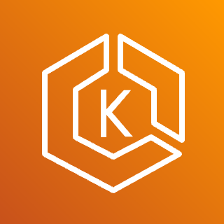


SaaS DevOps challenge
Amazon EKS cluster
Shared services
Pool namespace (n-tenants)
Product
Order
Payment
Product
Onboarding
SaaS admin
Silo namespace (tenant-1)
Product
Order
Payment
Product
DevOps and provisioning
Silo namespace (tenant-2)
Developer
Tenant
provisioning
Product
Order
Payment
Product
SCM (Git)
Product
Hybrid namespace (tenant-3)
Product
CI/CD
Order
Payment
Order
Payment
Silo namespace (tenant-4)
Product
Order
Payment
Notes:
But why does SaaS makes DevOps more complex? Consider a typical application – there are your microservices and your CI/CD deploys them Now imagine you need to deploy a new tenant in their own set of services (we call this the silo model), - and this could be for compliance reasons, or performance, or noisy neighbour mitigation So now you have a SaaS process, the tenant onboarding process, that can create new tenants deployments and resources. Some tenants will be fully siloed, and some maybe hybrid (where just some parts of the application siloed) And while the onboarding process creates new environments, your developers need to keep pushing changes out – and your DevOps automation process needs to be sophisticated to make sure all tenants deployments are updated, so the environment stay uniform.

Slide 6
Problem statement
Hybrid and silo models require provisioning of new resources
Tenant onboarding/provisioning must deploy latest version and apply tier/pod-based configurations
Code deployments update all tenant environments
Staggered deployments reduce risk

Slide 7





Automation tooling
Argo Workflows
Flux v2
Helm
Executes tenant onboarding and deployment workflows
Reconciles the state of the Amazon EKS cluster with the desired state in Git
Infrastructure as code: Defines the resources that are deployed for tenants
Defines the EKS-based application plane resources deployed for tenants
Deployment tooling
Application template
Git
Stores release configuration objects for all environments
Git logo by Jason Long; CC BY 3.0

Slide 8


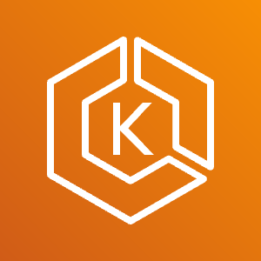
SaaS GitOps overview
Git repository
Push container image
Push container image
Application template
1.0.0
Source (1.1.0)
Build
1.1.0
Commit
Source (1.0.0)
Build
Update and push Helm chart
Update and push Helm chart
Developer
Tier configuration
1.x.x
deployment_config: {
“model”: “Silo”,
“tenantID”: “1”,
“config”: {}
}
Write
deployment_config: {
“model”: “Pool”
“tenantID”: “2”,
“config”: {}
}
Provisioning
Invoke
Argo Workflows
Write
Tier configuration
Deploy
AWS resources
1.x.x
AWS resources
Reconcile
Flux
Watch
Kubernetes resources

Slide 9
Session outline
Lab 1: Tenant onboarding and provisioning
Lab 2: Deploying application changes
Lab 3: Staggered deployments

Slide 10



Getting started with this workshop
You have access to an AWS account with any optional pre-provisioned infrastructure and IAM policies needed to complete this workshop.
The AWS account is only available for the duration of this workshop. You will lose access to the account once the workshop is complete.
Any optional pre-provisioned infrastructure is deployed to a specific AWS Region. Make sure that you are working in this Region; other Regions are blocked.
Review the terms and conditions of the event. Do not upload any personal or confidential information to the account.

Slide 11
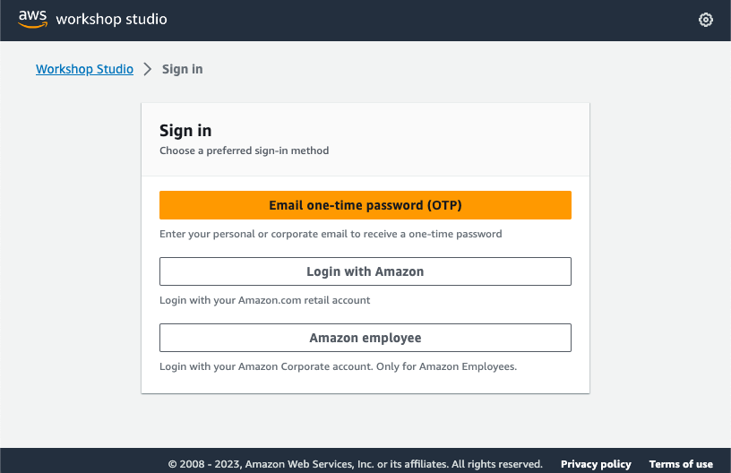
Step 1: Sign in using your preferred method
https://catalog.workshops.aws/join

Slide 12
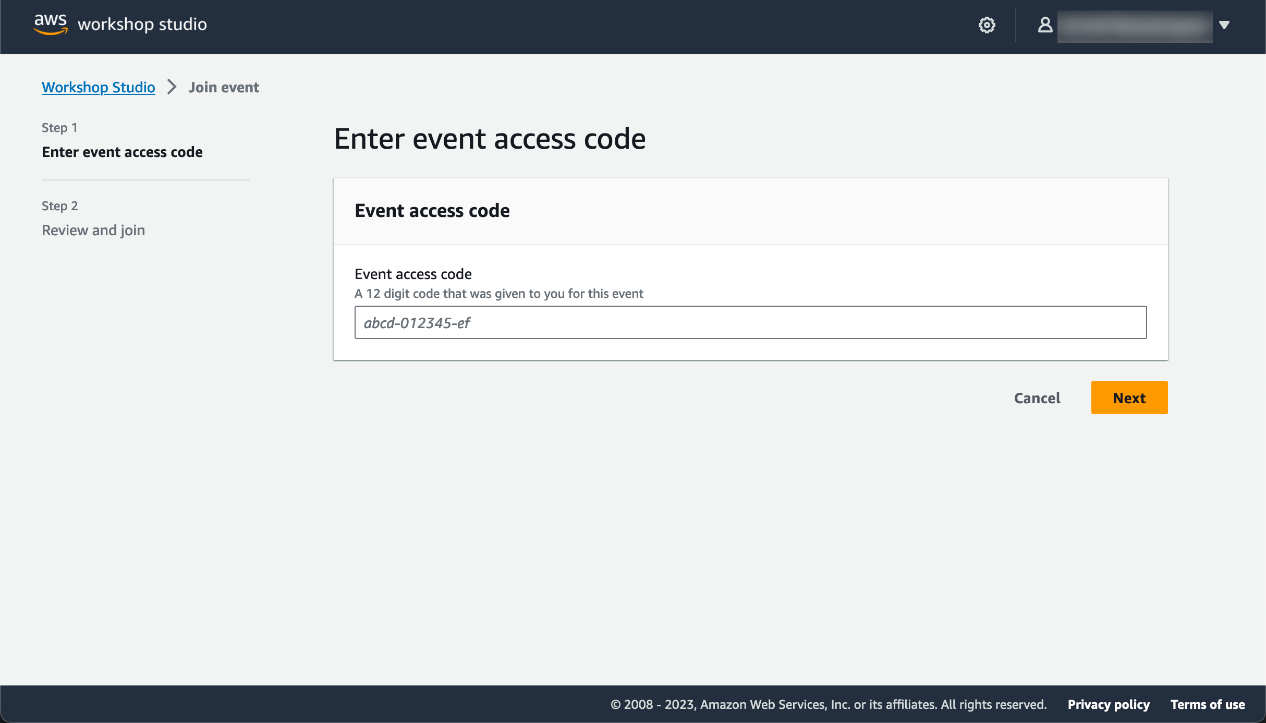
Step 2: Enter the event access code
Each session has a unique code

Slide 13
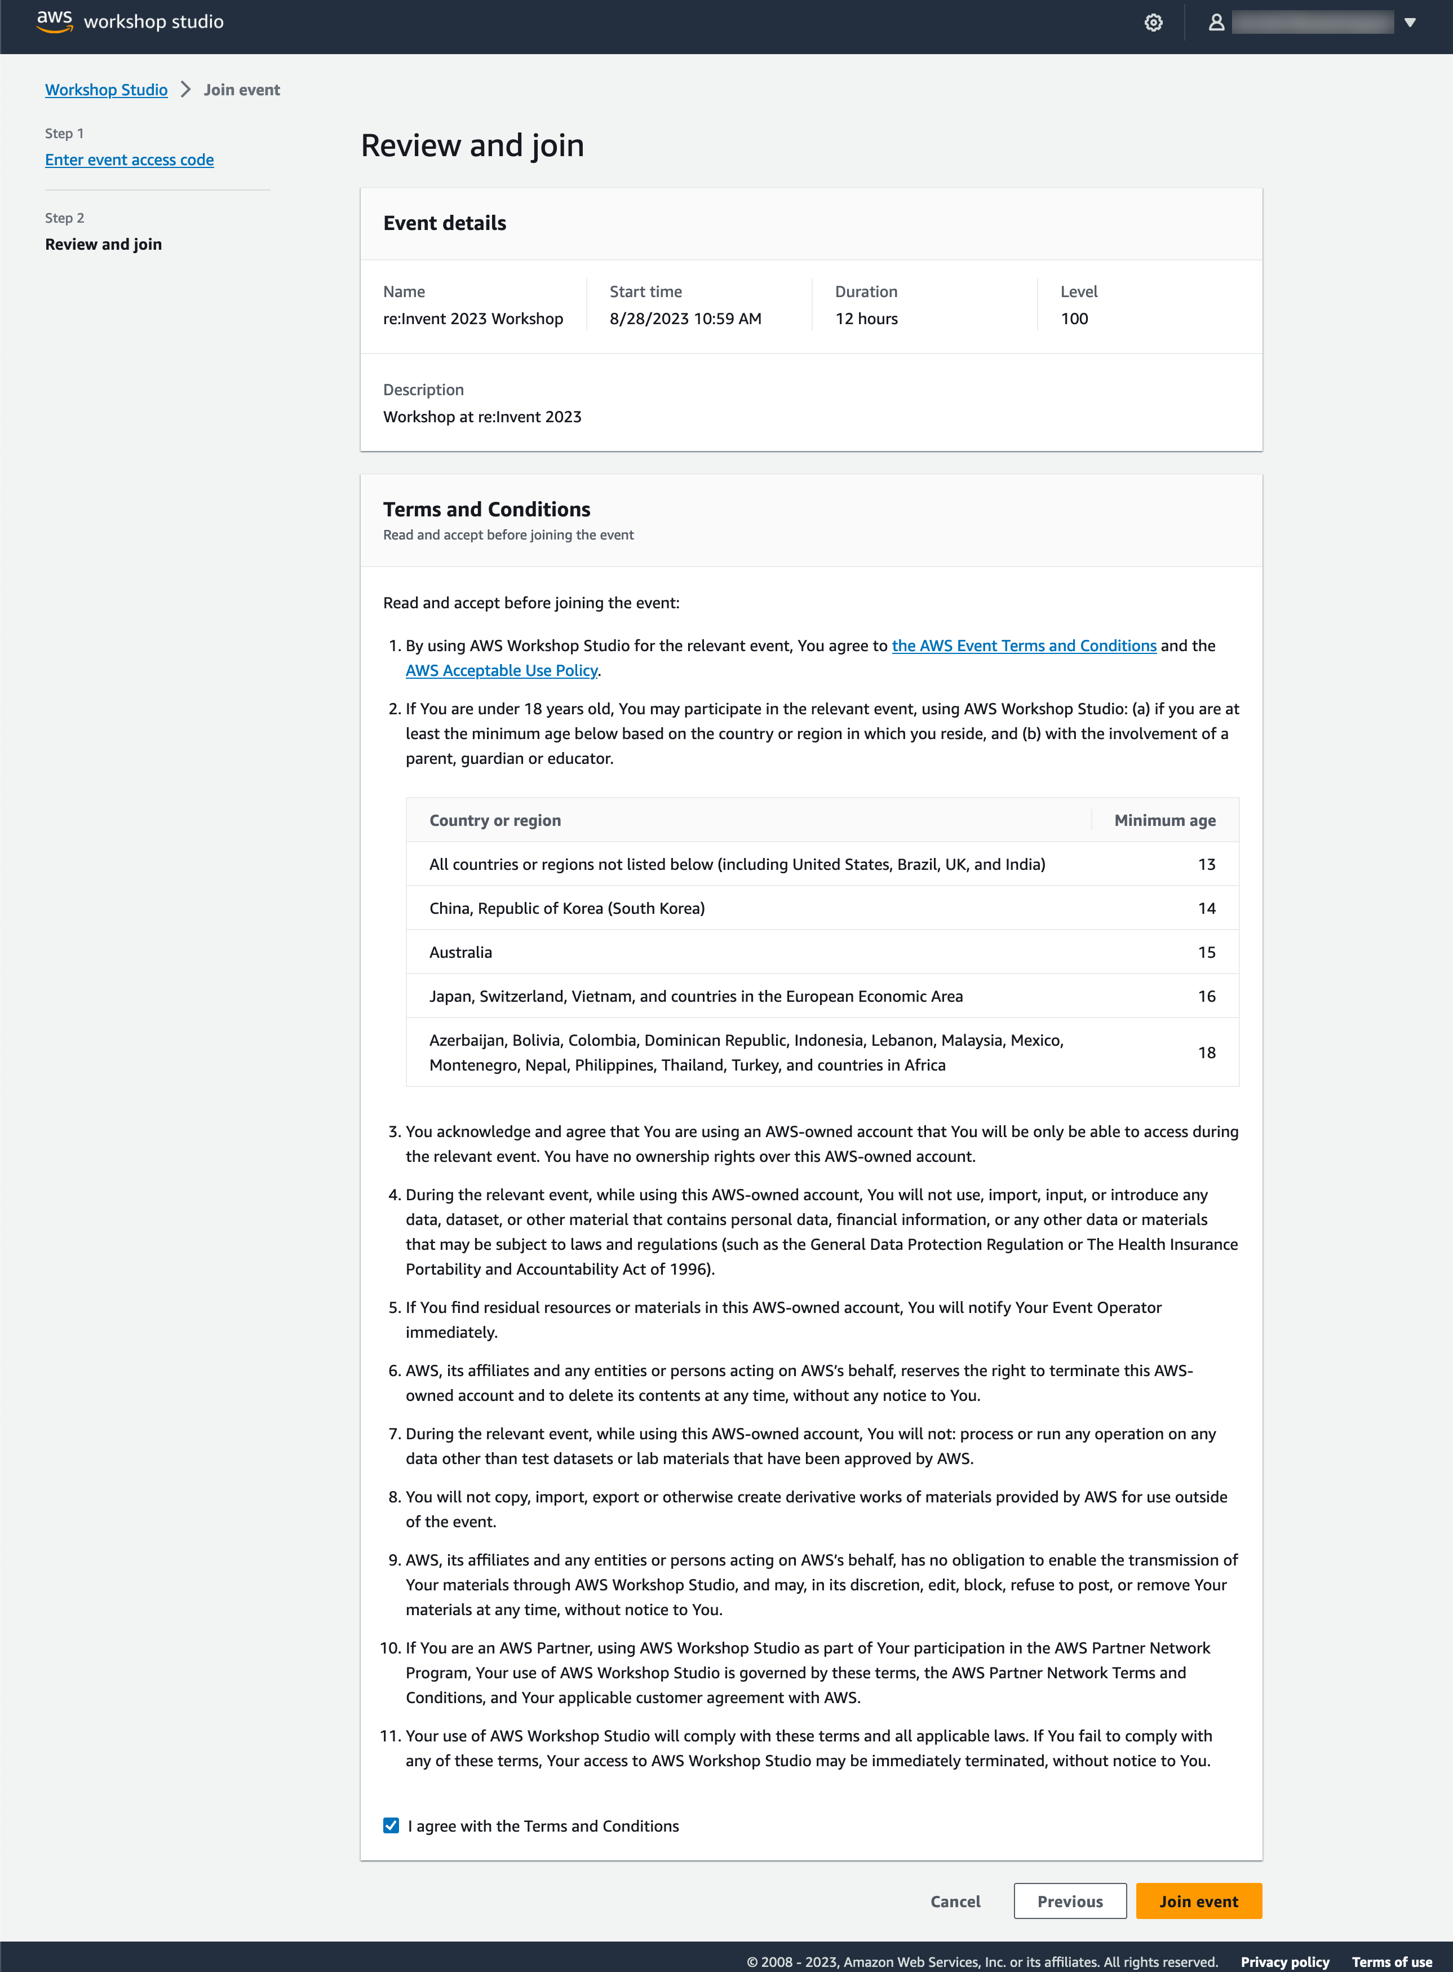
Step 3: Review terms and join event

Slide 14
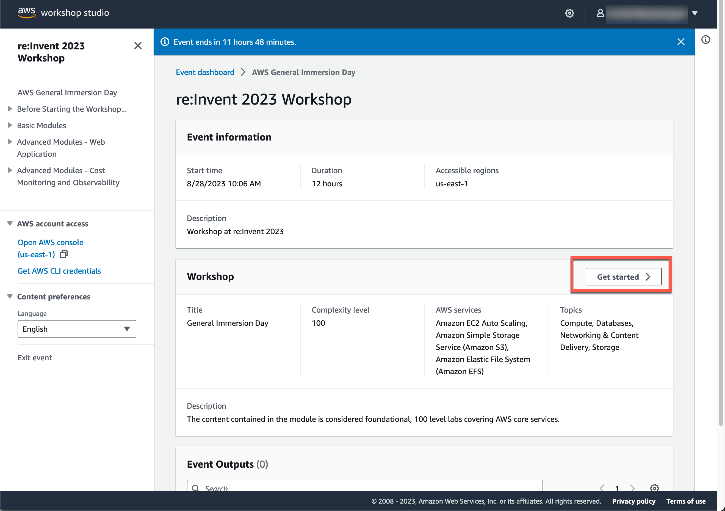
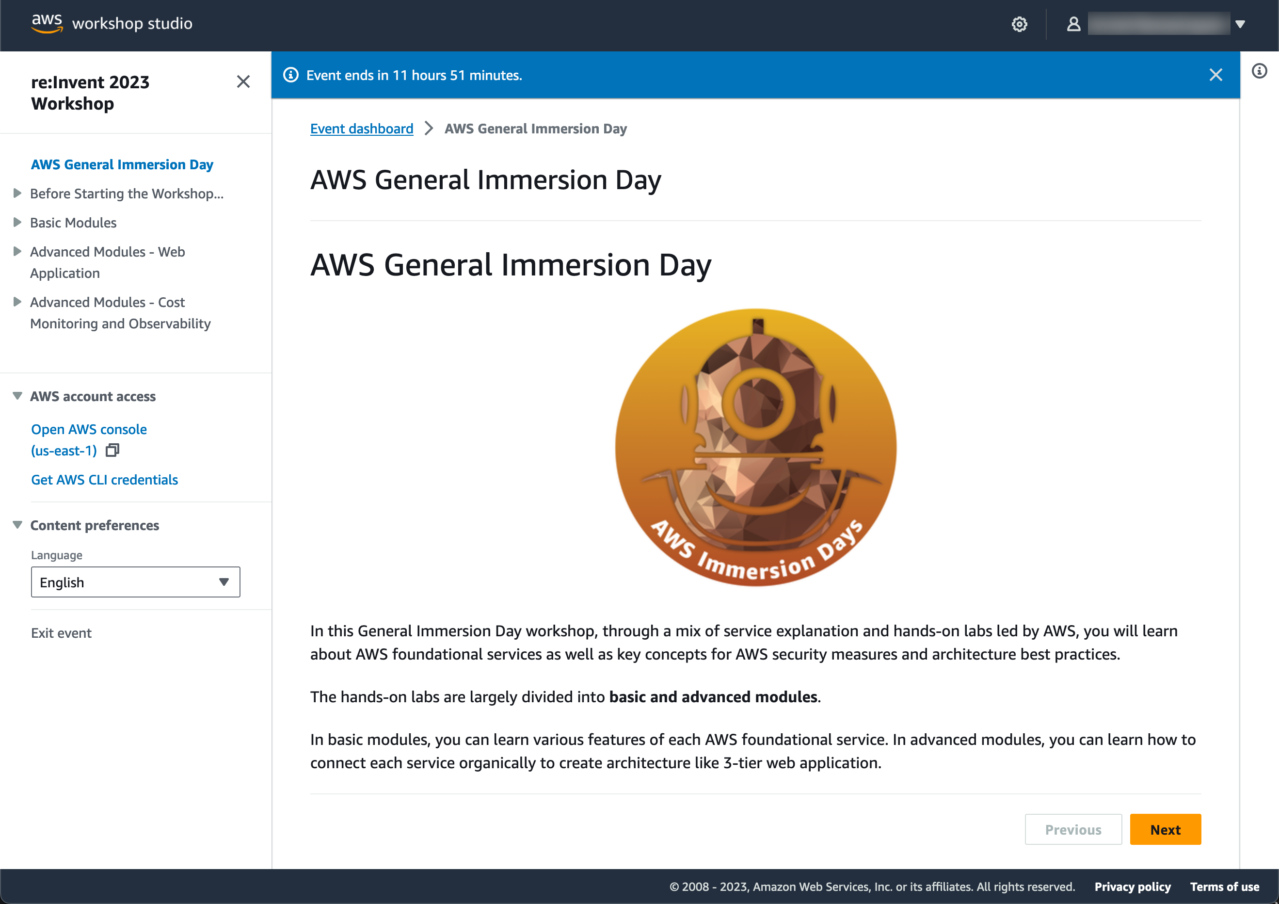
Step 4: Get started with the workshop

Slide 15
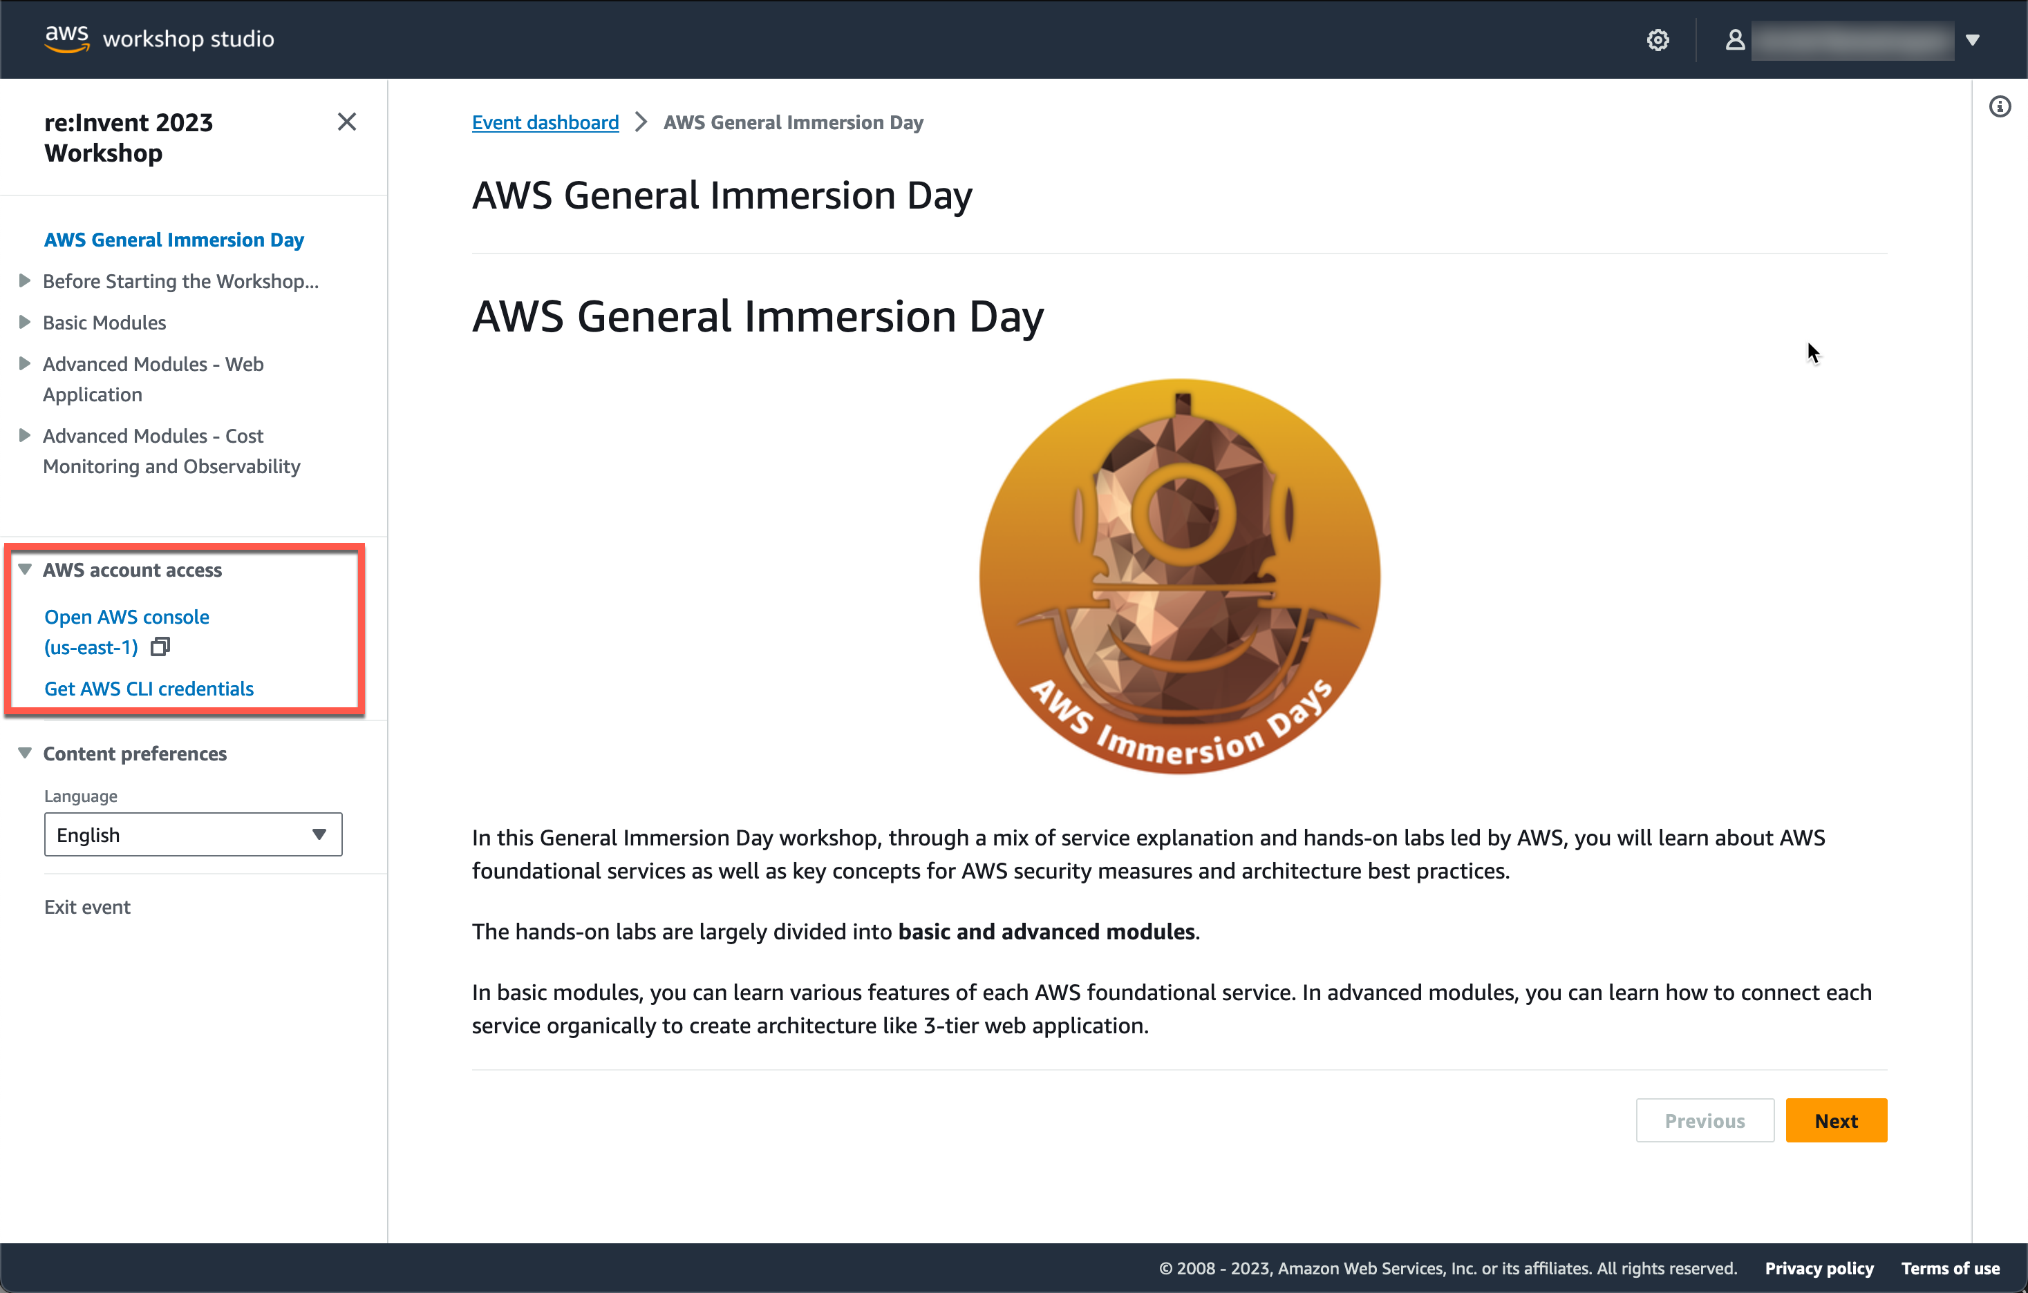
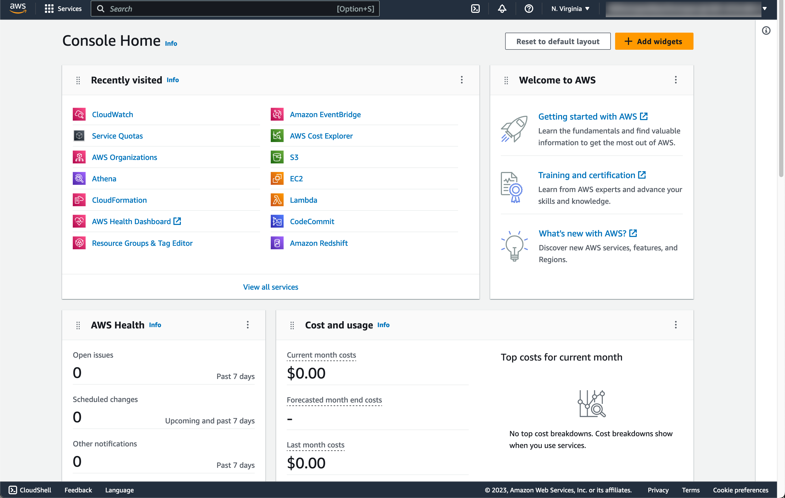
Step 5: Access AWS account
Access the AWS Management Console or generate AWS CLI credentials as needed

Slide 16
Event access code
https://catalog.workshops.aws/join
cc46-0cfd70-ee

Slide 17



Key takeaways
Package tenant
deployment definitions
Consider options that are immutable/versioned
Frequent releases and consistent environments
Git
Successful SaaS applications require frequent releases
and consistent environments
Git logo by Jason Long; CC BY 3.0

Slide 18
Additional SaaS sessions
Breakout sessions
SAS305 – SaaS architecture pitfalls: Lessons from the field
SAS304 – SaaS deep dive: Inside a scalable, efficient multi-tenant architecture
SAS406 – SaaS DevOps deep dive: Automating multi-tenant deployments
SAS306 – SaaS meets AI/ML & generative AI: Multi-tenant patterns & strategies
SAS308 – SaaS anywhere: Designing distributed multi-tenant architectures
ARC311 – Building cost-optimized multi-tenant SaaS architectures
BWP301 – SaaS operations in action: Buy with Prime
CON313 – Deploying multi-tenant SaaS applications on Amazon ECS and AWS Fargate
PEX205 – Benchmarking your SaaS business on AWS

Slide 19
Additional SaaS sessions
Chalk talks
SAS405-R – Federating identity in multi-tenant SaaS environments
SAS404 – Designing and implementing a SaaS cost-per-tenant strategy
SAS307 – SaaS tenant isolation: Patterns and strategies
SAS302-R – A look inside SaaS networking, routing, and integration patterns
SAS408 – Chaos and SaaS: Pushing your multi-tenant architecture
SVS320 – Building multi-tenant applications with AWS Lambda and AWS Fargate
ARC205 – SaaS jump-start: Exploring core multi-tenant strategies
BIZ207 – Integrate your SaaS application or security tool with AWS AppFabric

Slide 20
Additional SaaS sessions
Workshops
SAS401-R – SaaS microservices deep dive: Multi-tenancy meets microservices
SAS402 – SaaS multi-tenancy meets Amazon EKS: A hands-on deep dive
SAS403 – SaaS survivor: Building a rich multi-tenant operations experience
SAS301 – SaaS and AI/ML: Inside a multi-tenant AI/ML solution
PEX401-R – Building a multi-tenant SaaS control plane: An inside look

Slide 21
Thank you

